Slide 1


The History & Benefits of Microphone Trends
DEBRECEN UI COMMUNITY PRESENTS
Attila Gyöngyösi

Slide 2
The History & Benefits of Microfrontends
DEBRECEN UI COMMUNITY PRESENTS
Attila Gyöngyösi

Slide 3

Recommended Literature
https://martinfowler.com/articles/micro-frontends.html
https://www.thoughtworks.com/radar/techniques/micro-frontends
https://zendev.com/2019/06/17/microfrontends-good-bad-ugly.html
https://single-spa.js.org/

Slide 4
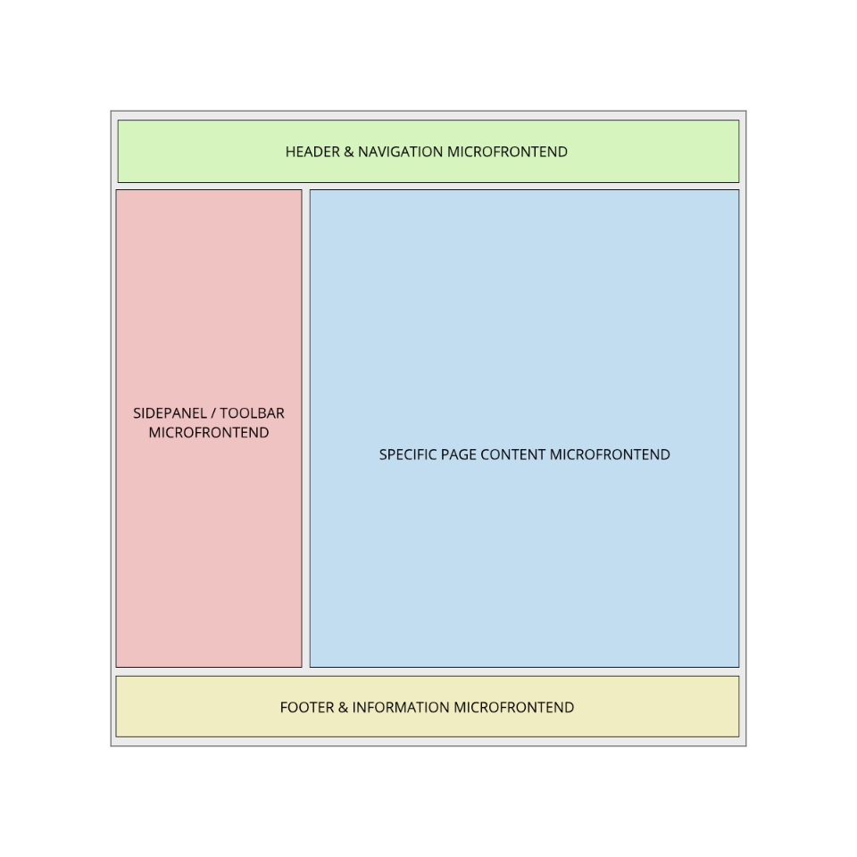
Microfrontend Architecture? What even is that?
Microfrontends are the logical next step in breaking up monolith applications.
A MFE-based application is composed of user features which are owned, independently developed and deployed by a dedicated cross-functional team where the backend follows a microservice architecture.
These independent teams are specialized in distinct business areas of the application.
Microfrontends appeared on Thougthworks’ Technology Radar as ADOPT in 2016.

Slide 5
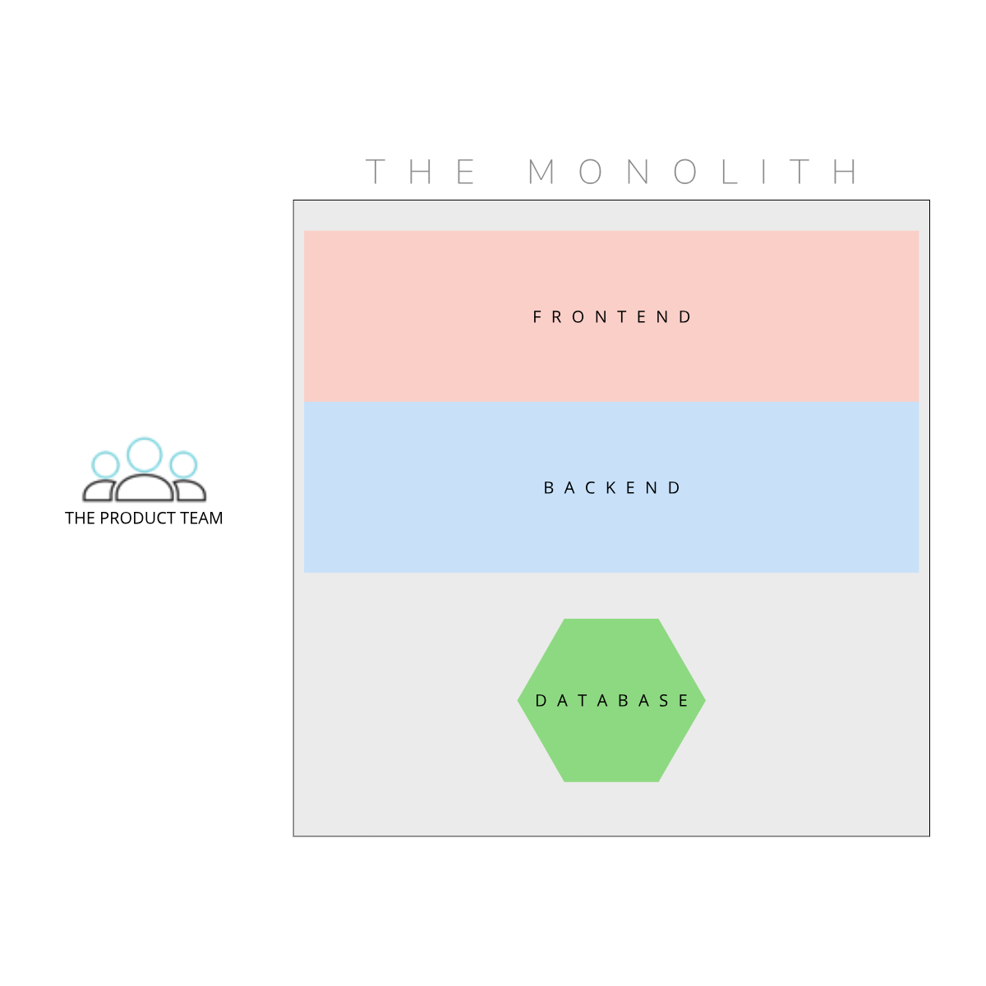
The History of Web Architectures
Single code repository
Tightly coupled application components
Huge artifacts, deployed to containers
Cross-functional team, but often cross-discipline members
Very hard to scale crucial application features
Easier to kick off and gather requirements for

Slide 6
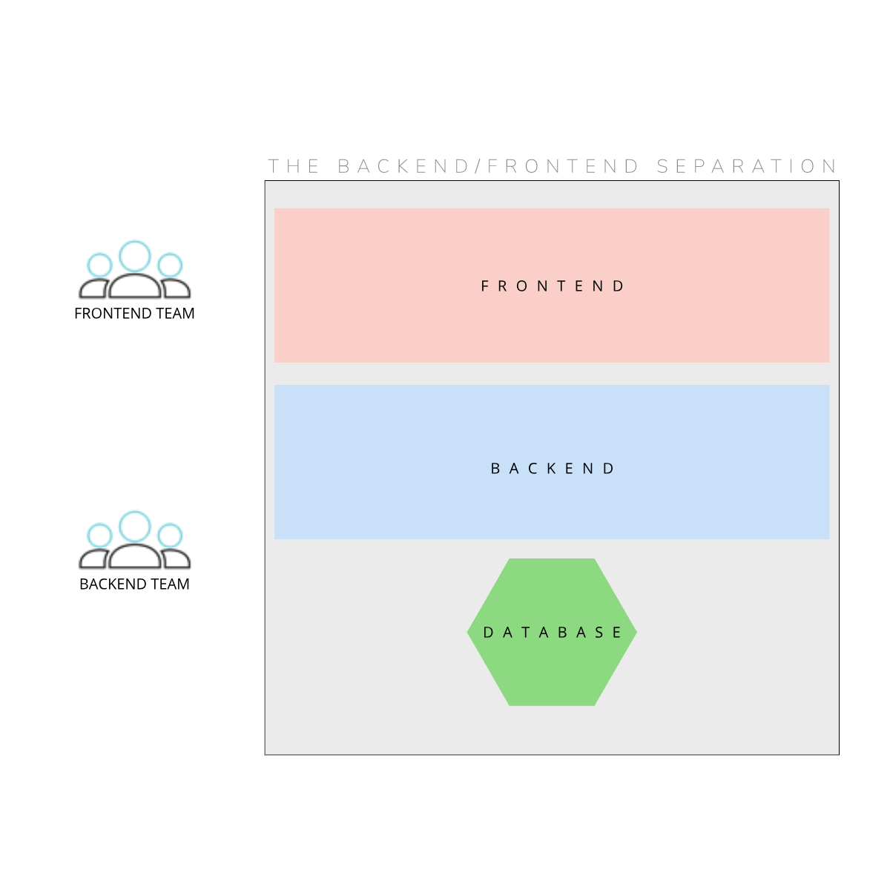
The History of Web Architectures
Single code repository
Frontend & backend are deployed separately
Dedicated Frontend + Backend teams
Still difficult to scale

Slide 7
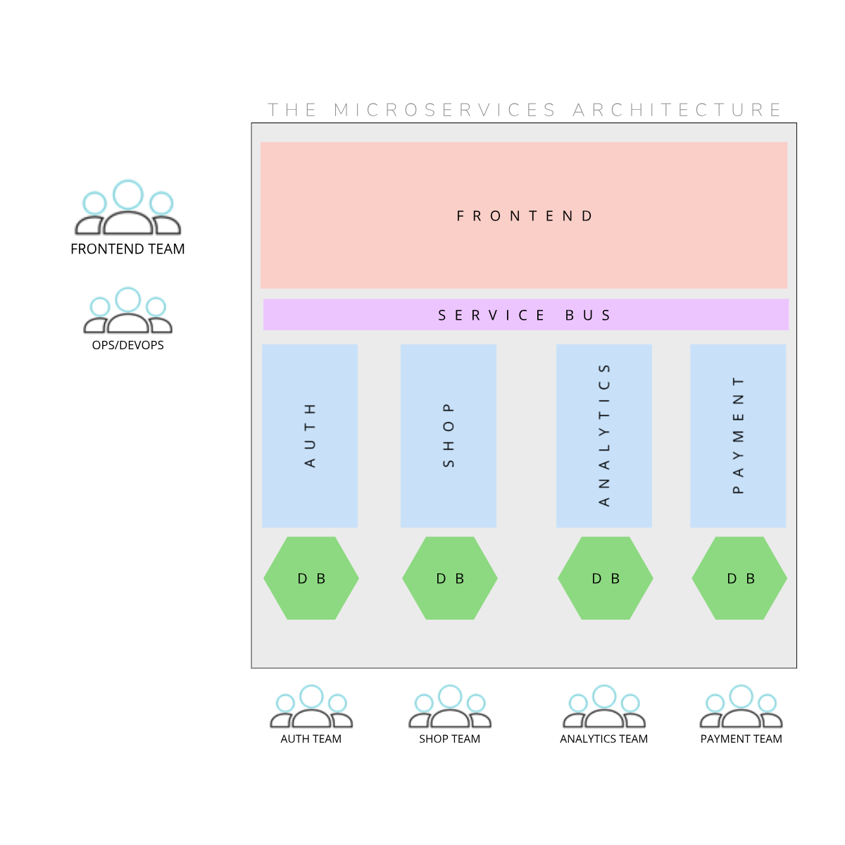
The History of Web Architectures
Backend is split up into smaller services.
Microservices are developed, deployed, scaled independently. Usually in different code repositories.
Microservice teams focus on a certain business subdomain.
There can be a service bus which routes service requests from/to frontend.

Slide 8
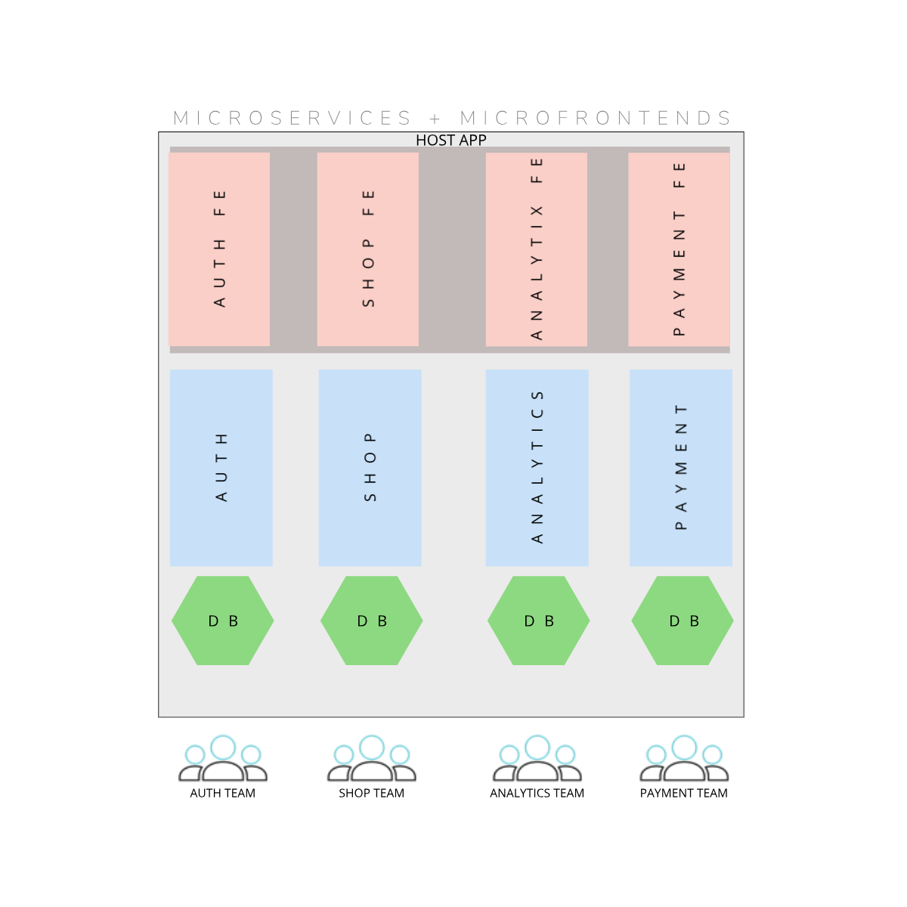
The History of Web Architectures
The application frontend is also decomposed into smaller microfrontends, or microapps, aggregated by a host application.
A microfrontend communicates with a dedicated microservice or a small subset of microservices
Cross-functional teams are formed on the boundaries of monolith decomposition. (DevTestSecOps)
Microservices and microfrontends are independently scalable
Microservices and microfrontends can be implemented in different tech stacks.
Monorepository can be utilized.

Slide 9




Benefits & Disadvantages of Microfrontends
Organizational freedom vs code dependency overhead
Independent deployment & scaling vs operarional overhead
Independent teams vs team resource pool capacity
Smaller sub-codebases vs impact on discoverability
Can facilitate easier migration of monoliths
Quicker onboarding for newcomers to a single MFE
Smaller test surface
Maturity: implementation details cover a wide spectrum (static vs dynamic MFE-host integration, framework-agnostic approach, global state vs state management libraries)

Slide 10
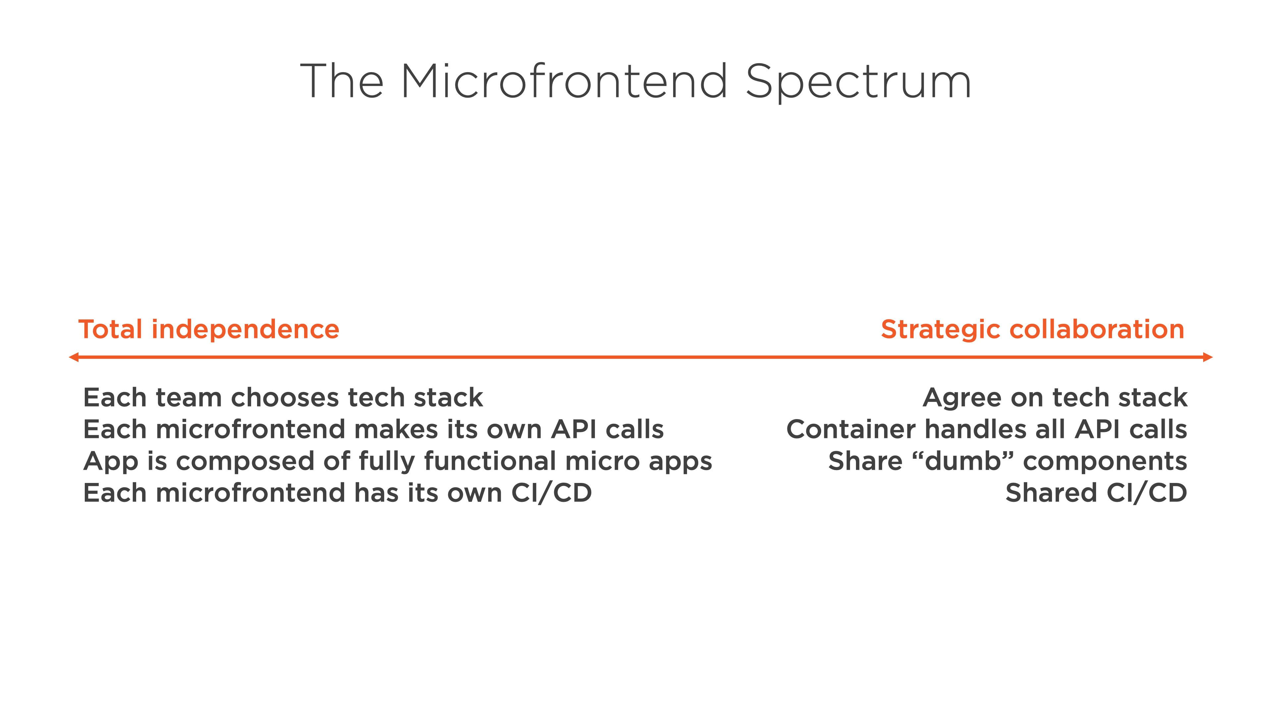
Benefits & Disadvantages of Microfrontends
https://twitter.com/housecor/status/1139504822930092033/photo/1

Slide 11
Questions?

